Slide 1
Security Updates
and
“Techie” Stuff
Dawn Wolf, Director of Information Systems

Slide 2
Join the Parish Online Community!
Parishforum@sfcatholic.org
This forum is meant for anyone who works or volunteers for one of the parishes or organizations within the Diocese of Sioux Falls. The forum is meant to be a place where users can post questions, ask for recommendations, and notify each other regarding events happening within the Diocese and/or Region.
*This is a restricted group and membership is managed by the IT staff at the Diocese offices.
Notes:
Questions come via email
You post questions to the group by sending an email.

Slide 3
Join the Group and Start Asking Questions
Email Dawn to be added to the group
How to ask a question?
Just email your question to parishforum@sfcatholic.org
Notes:
If you get a question and you want to respond, just hit reply and everyone in the group will see your comments. You can take your conversation offline and email someone directly as well.

Slide 4

Shared Documents, Forms, Templates
Shared Parish Resources-Team Drive
ANY file type
Download a copy and edit to suit your needs
Upload and share
Various categories
  General
  Religious Ed
  Youth Ministry
  IT, Media and Clipart Resources
*Email Dawn (dwolf@sfcatholic.org) to Join!

Slide 5

How to stay safe
in this Digital Age?
Notes:
These days security can make us all a little crazy and wonder what we can do to protect ourselves and our organizations. Being aware, educating ourselves and noticing details.

Slide 6
Biggest Threats in 2018
Phishing Emails
Sextortion
Sextortion scam emails
“Free” Pizza or Coffee or Amazon gift card
iTunes giftcard emails
Ransomware
Spoofing Father’s email asking staff to transfer money
Are you in the office?

Slide 7
Sextortion
It’s a sex crime in which a perpetrator blackmails a victim by acquiring personal information - typically pornographic images of that victim - and then demanding more under threat of posting those images in the public sphere.
Notes:
COVER YOUR WEBCAMS on your laptops when not in use! Urge all young people to do the same. Especially with computers in bedrooms.
Men posing as cute teenage girls-CatFishing
Men preying upon young girls after installing malware and software that can turn on their webcams, their microphones and keyloggers to capture usernames, passwords and read emails.

Slide 8
Sextortion SCAM Emails

Slide 9
I do know, [PASSWORD REDACTED], is your password. You do not know me and you are probably thinking why you are getting this e mail, correct?
actually, I placed a malware on the adult videos (pornography) website and do you know what, you visited this web site to experience fun (you know what I mean). While you were watching videos, your internet browser initiated working as a RDP (Remote Desktop) that has a key logger which gave me accessibility to your display and also webcam. after that, my software program obtained all your contacts from your Messenger, Facebook, as well as email.
What exactly did I do?
I made a double-screen video. First part displays the video you were viewing (you've got a nice taste haha), and second part shows the recording of your webcam.
exactly what should you do?
Well, I believe, $2900 is a reasonable price tag for our little secret. You'll make the payment via Bitcoin (if you don't know this, search "how to buy bitcoin" in Google).

Slide 10
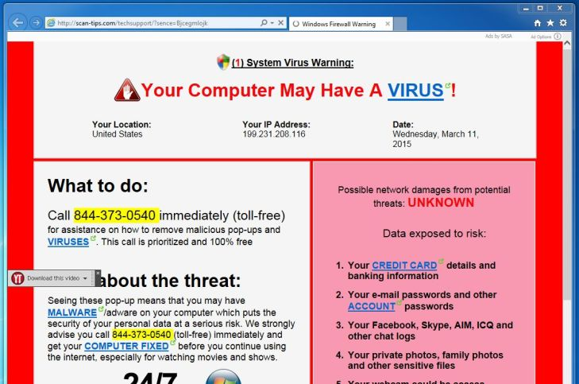
Notes:
This is an example of Browser HiJacking which is different than a ransomware attack.
Ransomware encrypts all your files and doesn’t allow you to open and view them.

Slide 11
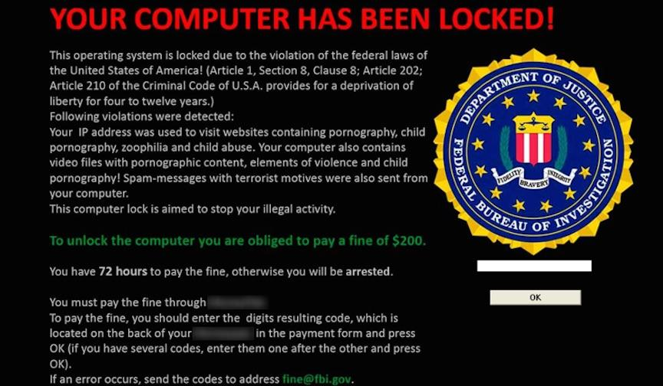

Slide 12
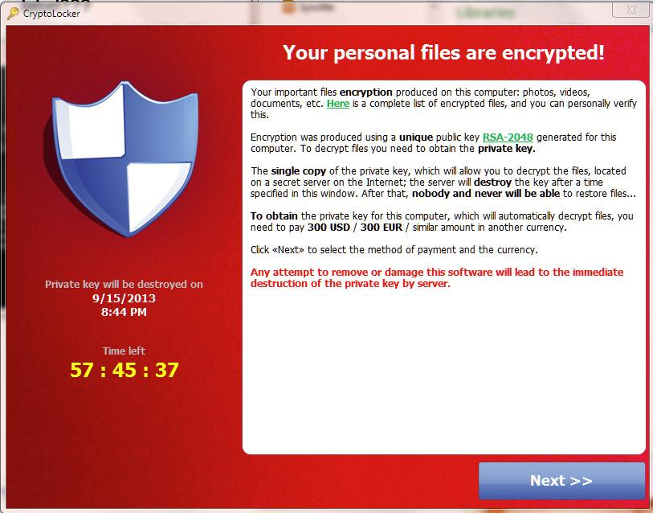

Slide 13
How did they get my email address?
More Importantly
How did they get my password?
Notes:
Email addresses are not meant to be private and secret. Address and phone number in the old

Slide 14
Just SOME of the Data Breaches...
Equifax
Kmart
Home Depot
Target
Macy’s
Aidias
Panera
Forever 21
UnderArmour My Fitness Pal
Arbys
MyHeritage
Ticketfly
Sears
Delta
Best Buy
Saks Fifth Avenue
Sonic
JP Morgan Chase
Yahoo
Facebook
Adobe
AOL
eBay
T-mobile

Slide 15
Anatomy of a Spoof

Slide 16
Someone is impersonating me
If you believe someone has created a Gmail address to try to impersonate your identity, you can:
File a report with the Internet Crime Complaint Center
Contact your state's Office of Consumer Protection
Unfortunately, Gmail is unable to participate in mediations involving third parties regarding impersonation. Learn more in Gmail Terms of Use.

Slide 17
How to report a “Spoofer”
Gmail
https://support.google.com/mail/contact/abuse?hl=en
Microsoft
You can also report phishing by forwarding the email as an attachment to phish@office365.microsoft.com.

Slide 18
Have I been Pwned?
https://haveibeenpwned.com/
Check to see if your email address was included in a data breach.

Slide 19
Virtru-Email Encryption
Data Encryption for sensitive email content
Browser extension for web based emails
Also available for Microsoft Outlook desktop client

Slide 20
KnowBe4 Security Awareness Training
“Scam of the Week” emails
Great SHORT Videos (5 minutes or less)
Non Punitive Phishing Tests
Trains Users to be Skeptics
$10 per employee per year

Slide 21


Slide 22
50+ Parishes now using Google Sites
Let me help you refresh an existing site or develop a new one!
Notes:
Let’s start migrating older sites to New Google Sites! Again let me help!
Google site migration tool from old classic sites to new google sites

Slide 24
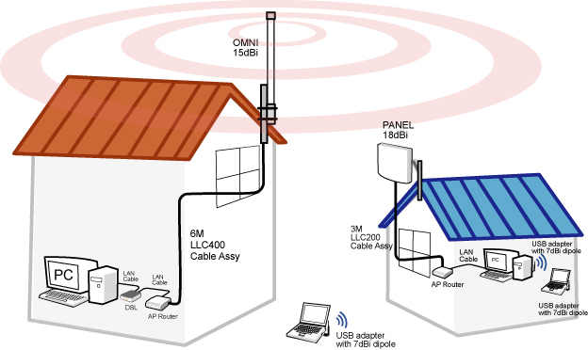
Extending Your Internet
Notes:
Many of our parishes are using Formed.org and other streamed media in their faith formation classes. If your parish hall or RE center is seperate and doesn’t have internet, it makes it difficult to provide that content. But paying an additional monthly fee for internet at that location can be quite expensive on already strained budgets.
Monthly fees for internet typically range from $75-$100 per month.
Setting this up per building will run approximately $2,500-$3,000. Return on investment in 2-3 years.

Slide 25

WiFi/Network Issues
2 Routers on a Network is BAD!
Access Points vs Routers
A router is a device that sends packets to destinations (routes them). And an access point is a device that allows wireless devices to connect to it by means of the antennas

Slide 27

Software LifeCycle
Office 2003-Ended April 2014
Office 2007-Ends October 10, 2017
Office 2010-Ends October 13, 2020
Windows Vista-Ended April 2017
Windows 7-Ends January 2020
Notes:
Doesn’t mean that these programs stop working BUT they will no longer be patched or updated.

Slide 28
TECHSOUP.ORG
Microsoft Windows and Office Software
Office 365, Office 2016, Windows 10 OS, Server software
Adobe Acrobat Pro-Edit PDF and create electronically fillable forms
*Windows 7 and Office 2010 will no longer be supported as of 10/2020

Slide 29


Slide 30
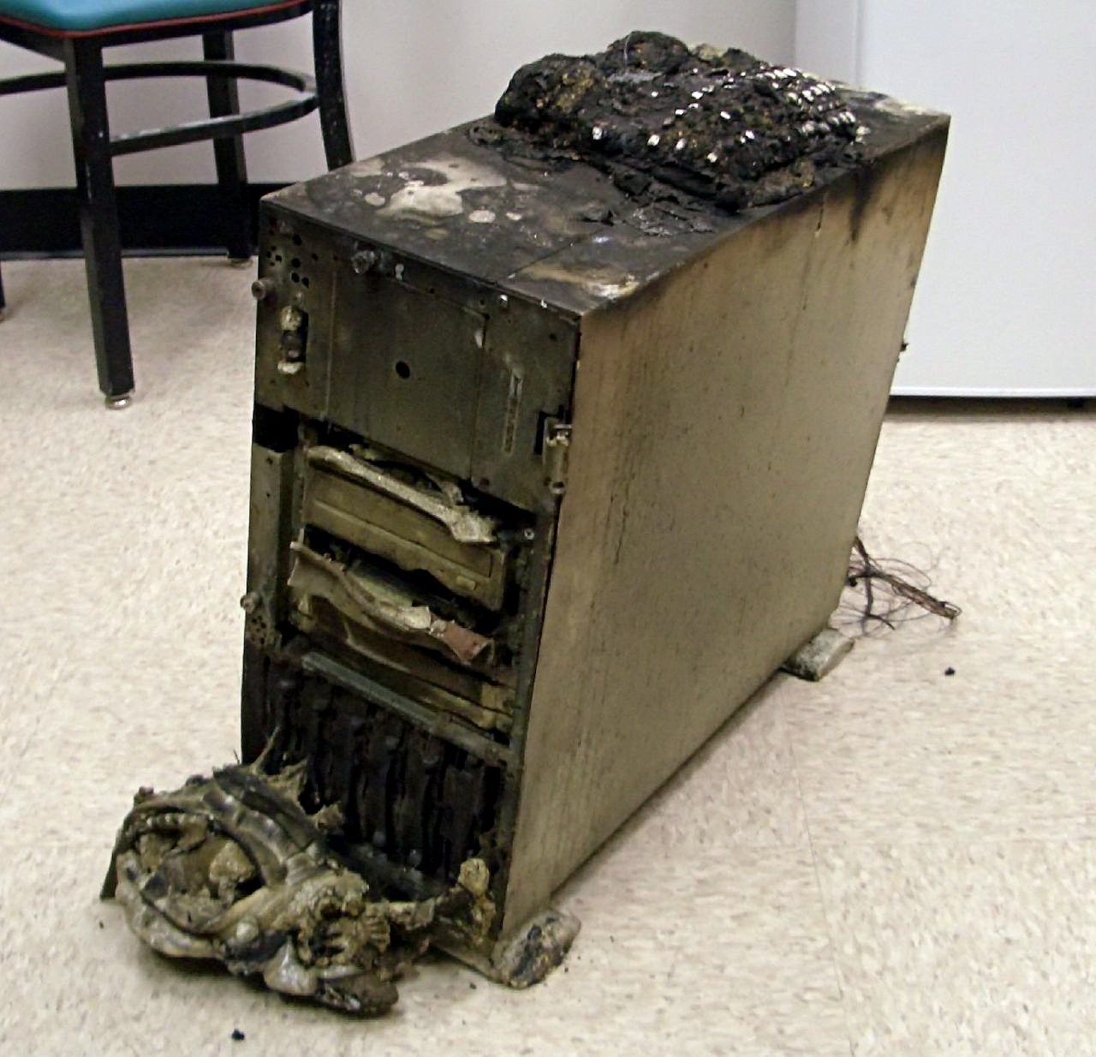
Backup!Backup!Backup!
Notes:
Online BACKUPs are my favorite because they take the human error out of the equation for the most part. Staff changes, people get busy, backups get forgotten
Google’s Backup and Sync
Carbonite, Mozy Home, MyBackupplan etc.
$60 a year is a small price to pay for have your data safe!

Slide 31


Slide 32
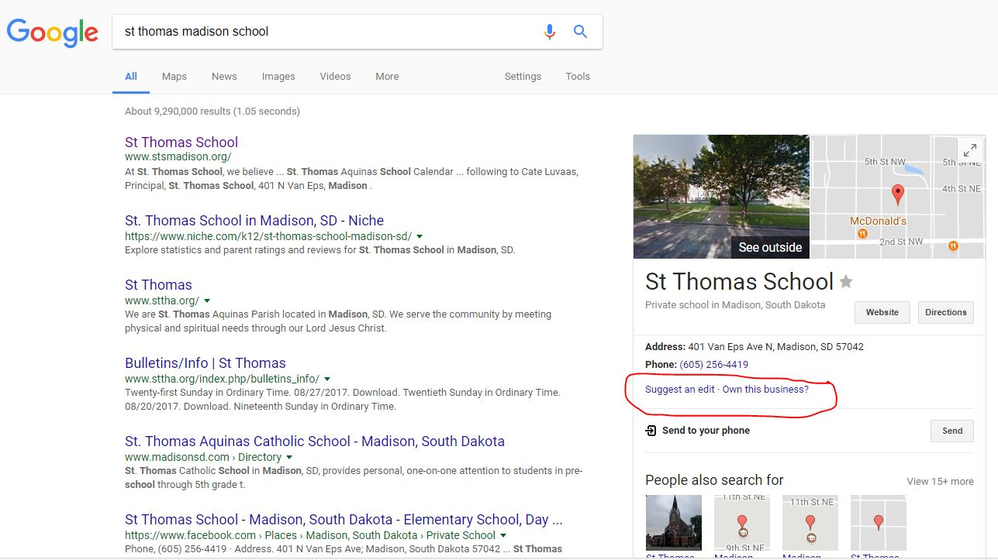
Claim Google and Bing Business Pages
Notes:
to learn more about the Knowledge panel click on the link
Always click on the Own this business and submit your additional info to Google
If you don’t have one
ADD ONE

Slide 33


Slide 34
YOUR CFSA DOLLARS AT WORK!
Virus/Ransomware/Malware Removal
Hardware and Software (Good Deals!)
Network troubleshooting and setup
WiFi Setup and Security
Websites
Social Media
Google Apps (G Suite) for Non Profits and Education
Internet Safety presentations (Kids, Teens, Parents)
ParishSOFT
Staff Training-Parish and School
Audio/Visual equipment
Digital Signage
Techsoup
Email issues
Printers, copiers and scanners
Microsoft Operating Systems and Microsoft Office installations and troubleshooting

Slide 35
Save $ on new pc’s
We custom build desktop PC’s
Multiple Vendors/Resellers to compare
Saving $100-$150 per pc
Wipe Data and Recycle Old Pc’s

