Slide 1
ParishSoft Update and Engagement Tools
By: Carla Haiar

Slide 2
Email from Parishsoft
If your email account is a sfcatholic.org or a secondary sfcatholic.org account, you should be all set to send emails from Parishsoft.
Check the box next to the name you wish to email.
Click on the Email icon.

Slide 3
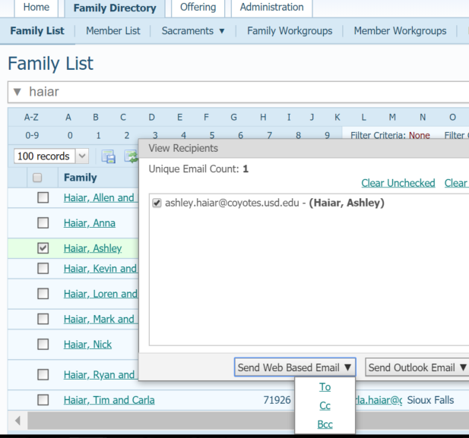
Email from Parishsoft
Select the Box Bcc for Blind Carbon Copy

Slide 4
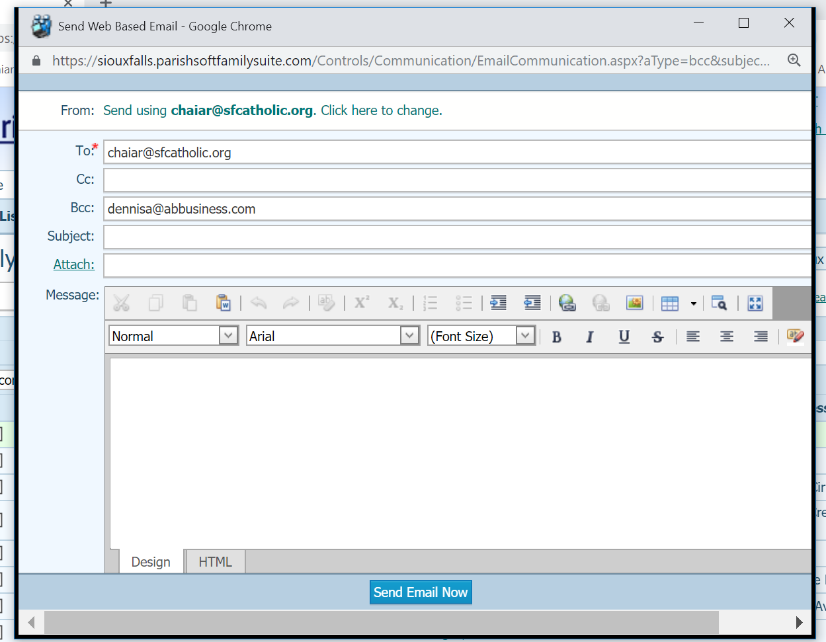
Email from Parishsoft
Populate the email content
Ctrl-C to Copy selected text
Ctrl-V to Paste selected text
Click on Send Email Now
Remember, your email service provider limits the number of emails you can send in a day.
You can only send 100 at a time. Page through 100 records at a time and use Ctrl-V to paste in to the content.

Slide 5
Diocesan Web Portal
Access to Diocesan Documents that are protected and must be accessed with an sfcatholic.org email account or sfcatholic secondary domain account.

Slide 6
WorkGroups from IQ
Any query results can create a Family or Member Workgroup.

Slide 7
ParishSoft Roadshow to Des moines
Thank you to all that ventured out of your comfort zone, hopped on a bus and learned a thing or two!
Highlights!
IQ and Workgroups
New Online Giving has forms
Deleting Sacramental Records
Integration with other products is coming

Slide 8
ParishSoft IQ and Workgroups
Should I purchase IQ?
Power User, willingness to learn and an understanding query language is necessary.
Validate and Verify

Slide 9
Deleting sacramental records
Matrimony Records

Slide 10
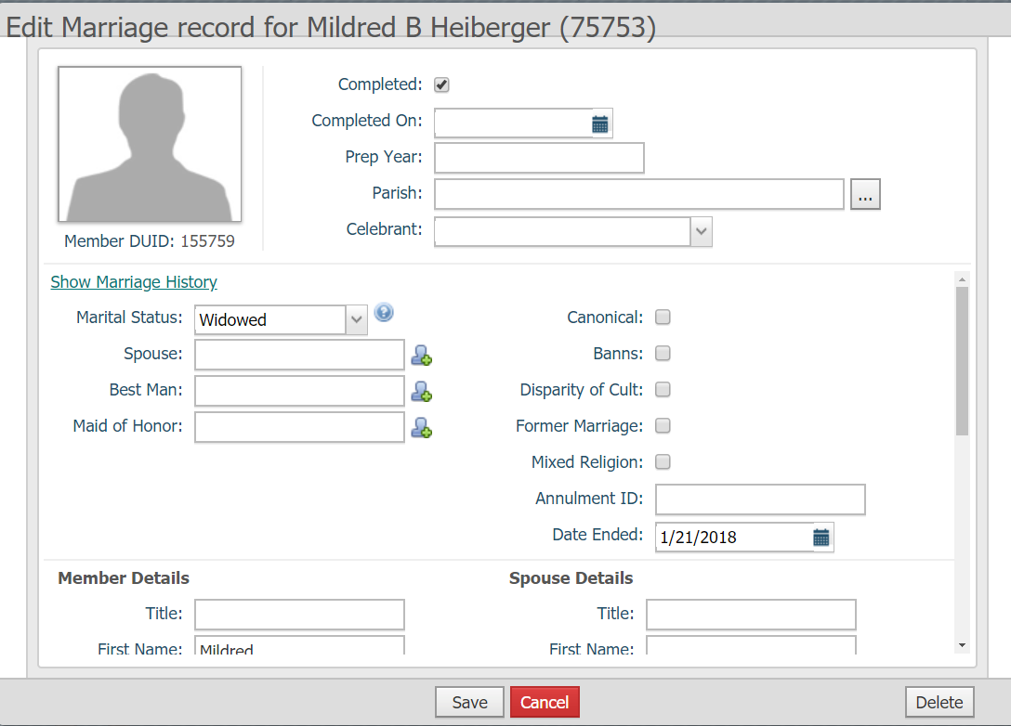
Deleting sacramental records
Matrimony Records
Edit Detail – Delete button appears.
You will be prompted to confirm.
There is NO UNDO!

Slide 11
Integration with other products
Parishsoft promises increased partnering with other providers to enhance their database.
Remember to ADD Parishsoft to your mobile devices.

Slide 12
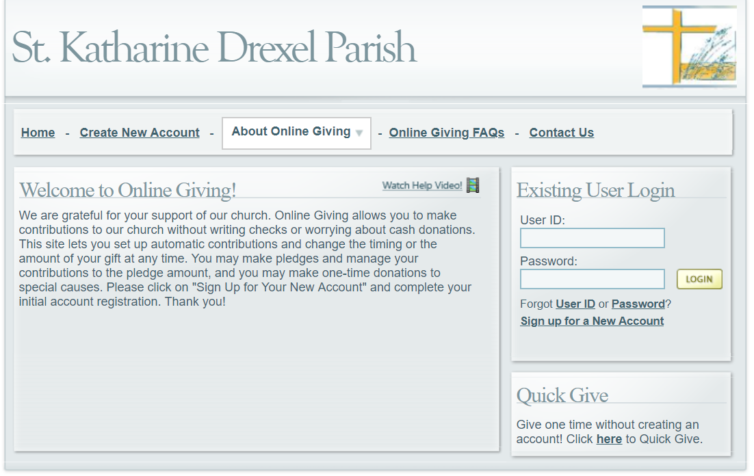
Online Giving by Parishsoft
Online Giving does NOT have a sunset date YET (yes I have been saying this for YEARS)!
Options:
Parishsoft’s Online Giving
WeShare
OSV
Vanco

Slide 13
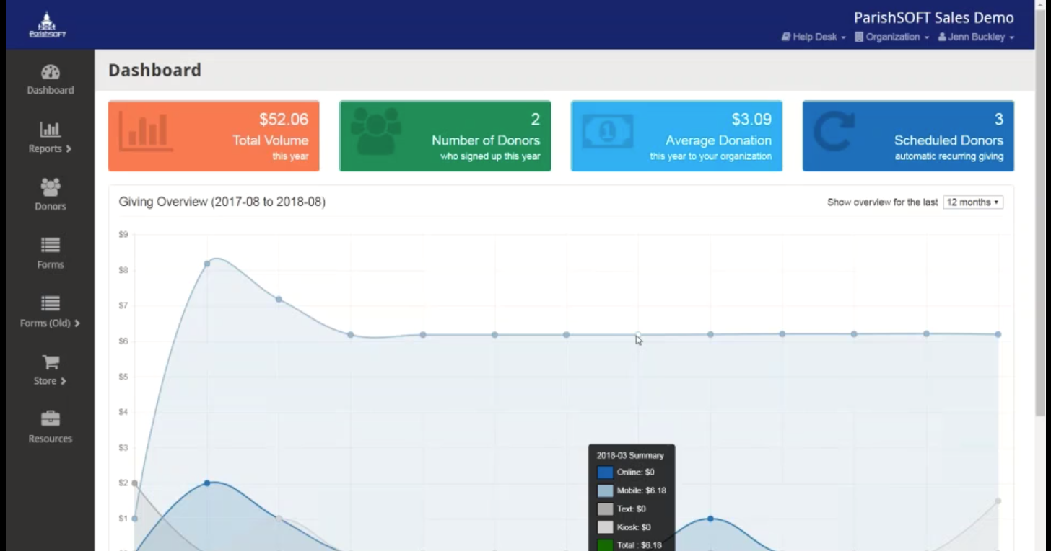
Parishsoft Giving
Integrates with Parishsoft Family Suite
10$ / month for up to $5000 donations a month
Text to give is available for $5/month
1 parish is using this platform
3.0% + .39

Slide 14
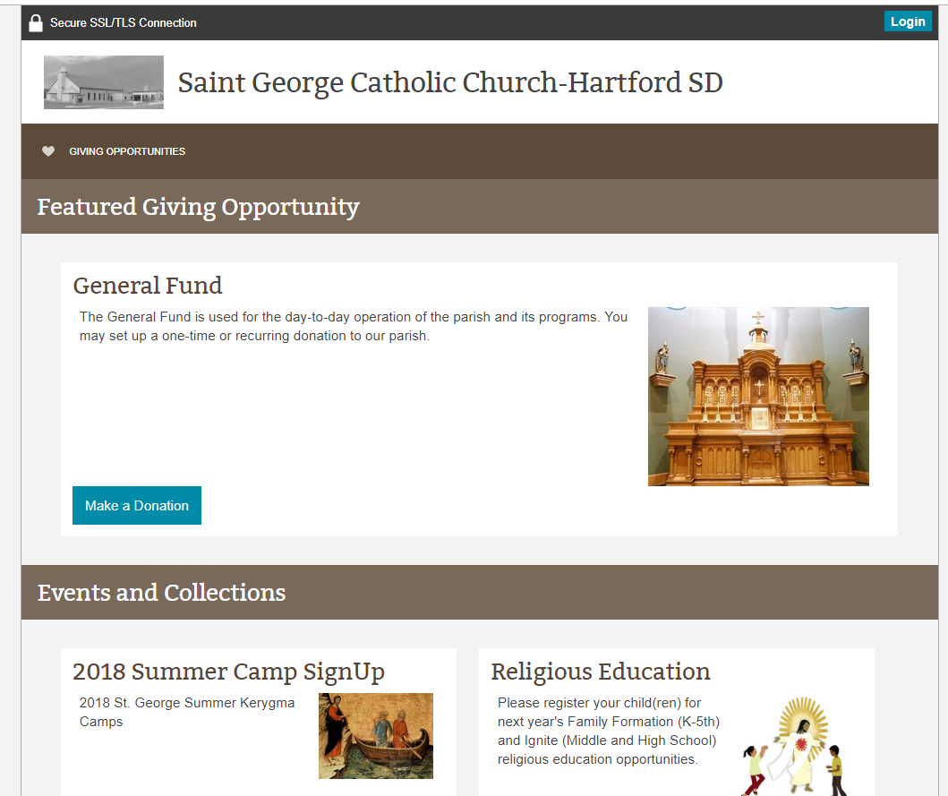
WeShare
Easy to set up and use
Integrates with Parishsoft
Ability to create forms and process payments
12 parishes are using the platform
$29/month plus transaction fees of 2.9% +.30

Slide 15
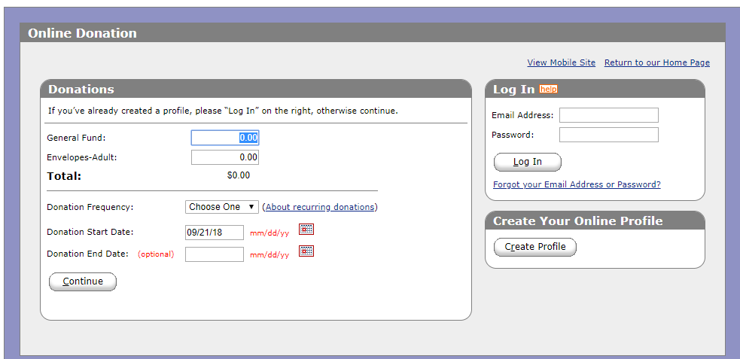
Vanco
Text to Give Feature
Releasing Kiosks for giving.

Slide 16
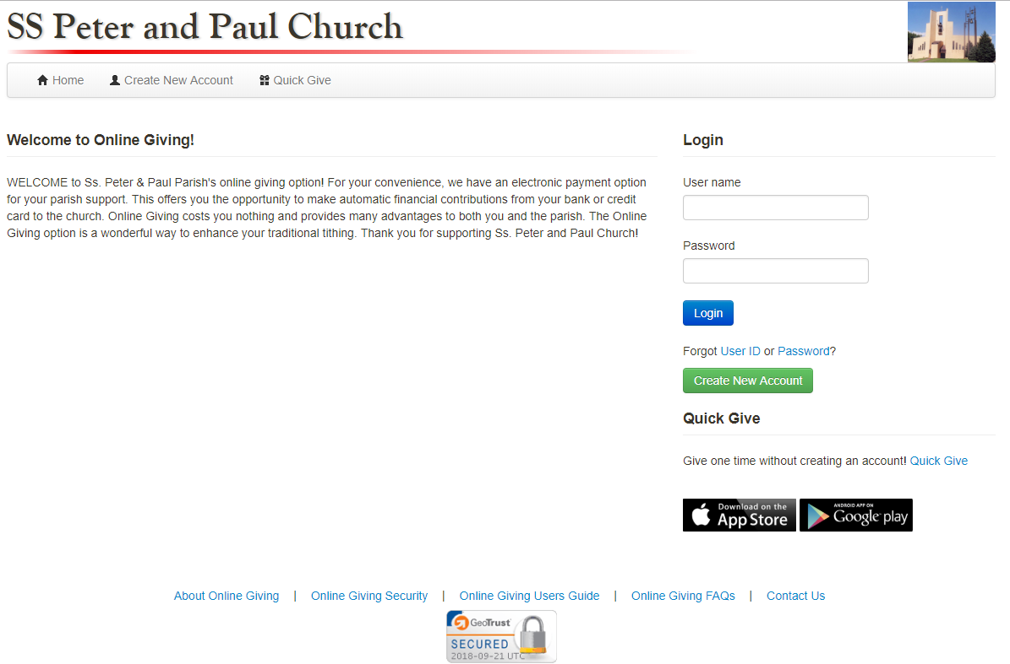
OSV
Diocesan portal for CFSA
Allows OBO reporting, we will continue to use
Releasing updates for Forms (not their yet)

Slide 17
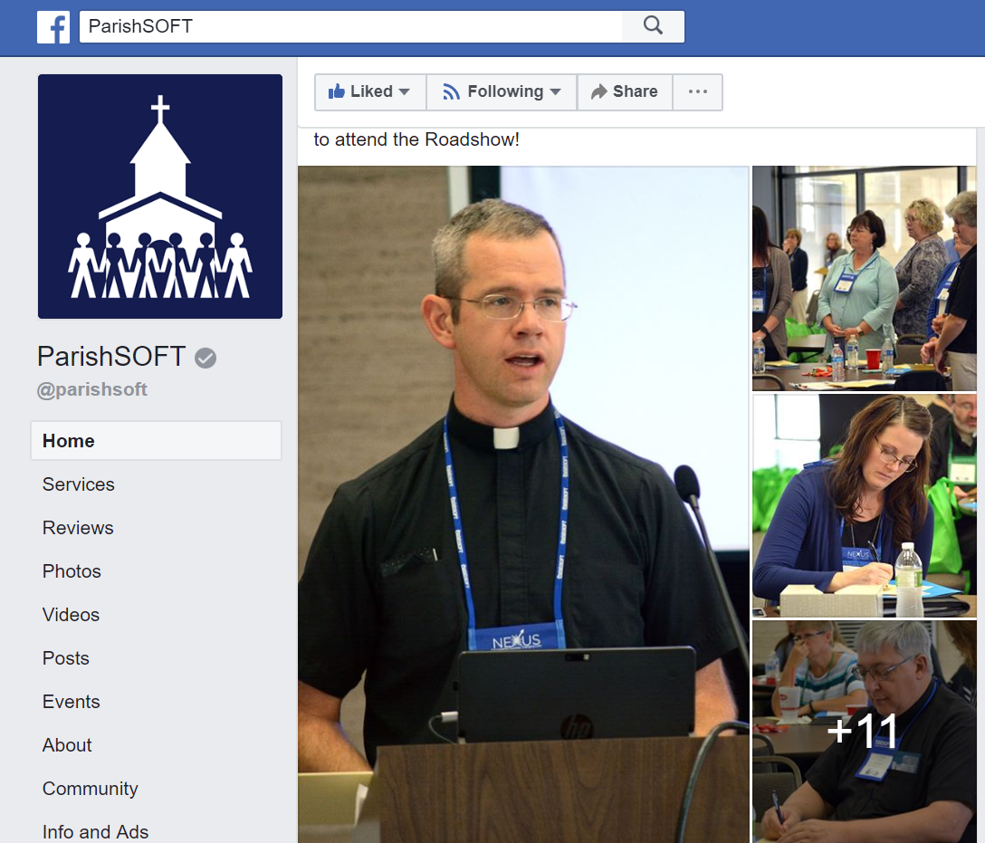
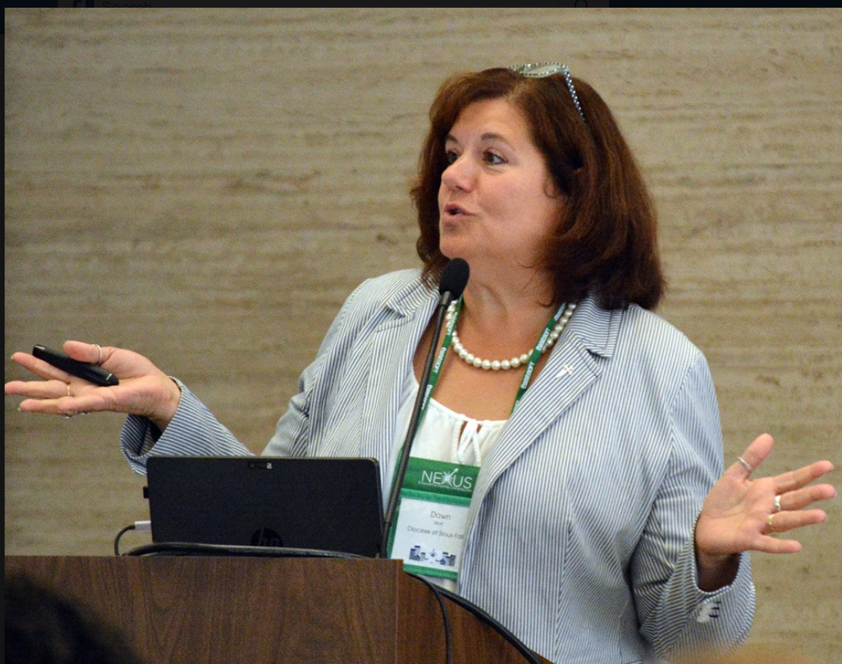
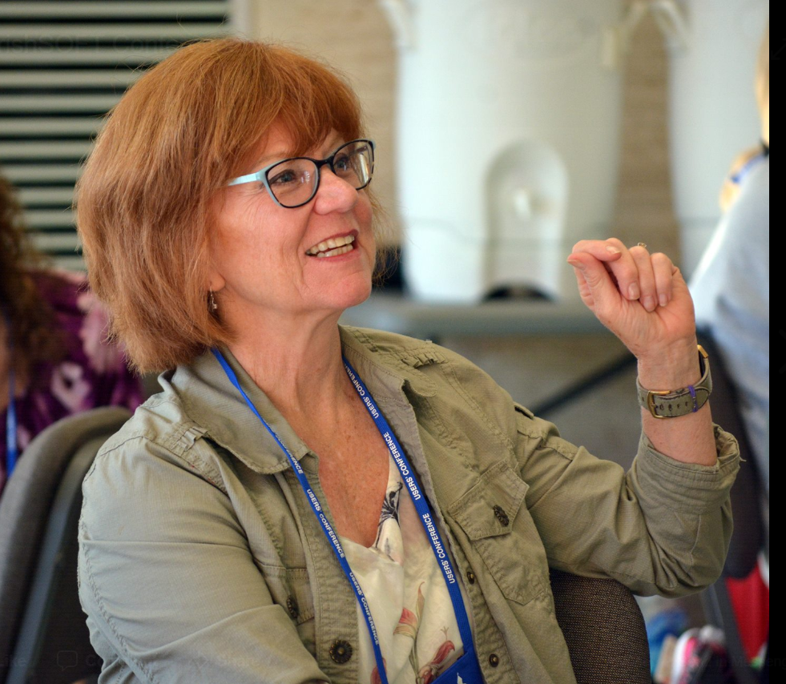
Thank you
Des Moines!
Fr Bob, Julie of St Teresa and Carol of Brandon all made the Parishsoft Facebook page, check it out!

Slide 18
Privacy of Sacramental Records
Burial records, particularly if there is a parish cemetery ministry, should be provided when asked. Good practice would be that a name and approximate date of death would be given and the cemetery could confirm that a person by that name is buried there.
One caution: burial records have be treated carefully as they do not and cannot confirm identities. Verbiage when relaying information from parish records is all the more important.

Slide 19
Online giving options
ONLINE GIVING
WeShare by Lpi
Sixteen parishes are utilizing product
Appreciate ease of setting up new fund
Issue with Duplicate Contribution ID
Transaction level fees
VancoText to Give
Dated and a bit clunker on the user interface
Transaction level fees
ConnectNow Giving from ParishSOFTNo transaction level fees
OSVNo Transaction Level Fees
Next generation software

Slide 20
Meeting people where they are at ….
And MANY are on a mobile device … so let’s look at an app!

Slide 21
What’s an app?
An app is computer software,
or a program,
most commonly a small, specific one
used for mobile devices.

Slide 22
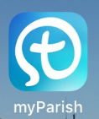
Why get an app?
MyParish app is specifically built to enrich faith.
Diocesan Solution:
Low cost to implement
Consistent look and feel for ALL parishes

Slide 23
An App Provides
Push notifications (messages can be sent directly to device)
Quick response on device
Accesses device features such as location
Interacts with phone, prayer reminders, mass reminders and groups
Feeds and ease of use
Apple released new guidelines for companies trying to “market” an app when it was not a native app. These apps are no longer functioning (LPi).

Slide 24
Isn’t a website good enough?
Not anymore; different people different preferences
Not mobile responsive
Slow browser, search and open functions
Good news, since our website is built on FEEDS, it plugs in VERY well to an app

Slide 25
Products Reviewed
Product | myParishApp | The Parish Solutions Company | OSV Parish App | Solutio | Lpi
Company | Diocesan & Trinity Publications | Independent Company | OSV | solutio software | Liturgical Pubications
Type | Mobile app | Websites and Mobile Apps | Cloud | Moblie app and wedsite | Mobile app and Website
Platform | Cloud | Cloud |  | Cloud | cloud
Setup | $199 | $1,000 | $200 |  | $495
Monthly | $35/month / parish with admin login | $99/month | $99/month | $99/month | $39/month
 | Push notifications | Push notifications |  | Joomla platform | PHP and Zend Framwork
myParishApp will waive the $199 set up fee.

Slide 28
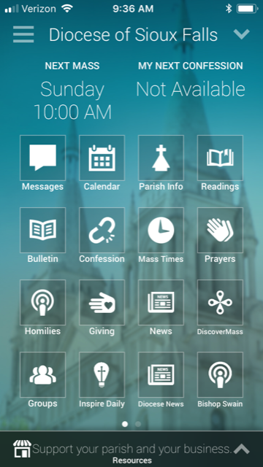
Diocesan Content on a Parish App (Free)
Diocese determines the default layout while the app is free. When a parish administers, they manage the content.
Diocesan Content can include:
Messages
Contact Us
Diocese News
Bishop Swain Homilies
Diocesan Calendar
Bishop Bulletin

Slide 29
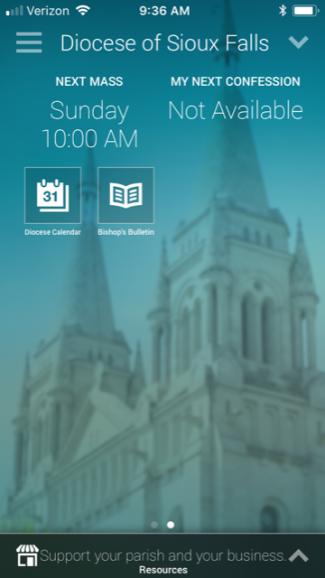
Parish Content
Every parish in our diocese will have its own app
FREE: Location, Mass Times, Confession, Parish Info
CHARGE: Parish Bulletin, Parish Calendar, Parish Giving

Slide 30
Contract and Fees
Diocese signs contract for ALL parishes.
If a parish wishes to customize (admin login), then it is $35/month billable directly to the parish.
If the DIOCESE signs ups, there is a launch date. The first year after the launch date is free.
There is no charge for missions.
Only one charge per linked parish.

Slide 31
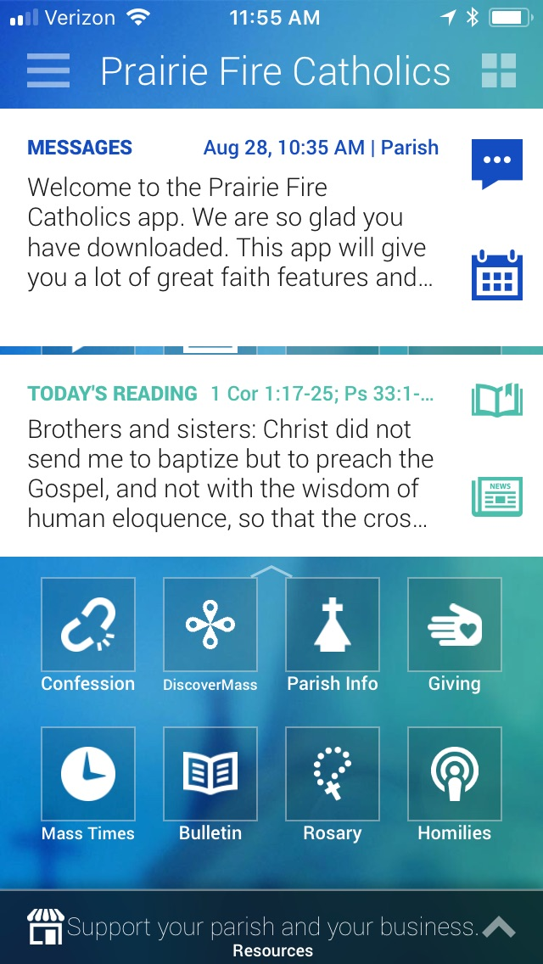
Workload?
Suggestion: Diocese should send one message a week with parishes doing the same for a total of 2-3 messages per week.
Note: Can SCHEDULE messages for the future.

Slide 32
Process from myParishApp
Each parish will get an app (even mission parishes and linked parishes) as app is driven by location
Text 88202 with the word “app”
Search for your parish
myParishApp will assist parishes with Download Sunday (implementation and sharing of app at each parish)
Download Sunday is determined by each parish. Every parish will receive a box with t-shirts, promo cards, and download cards. If they would like a banner and stand it will be $99 + $10 shipping.
The first year is free for ALL parishes from the Download Sunday date.

Slide 33
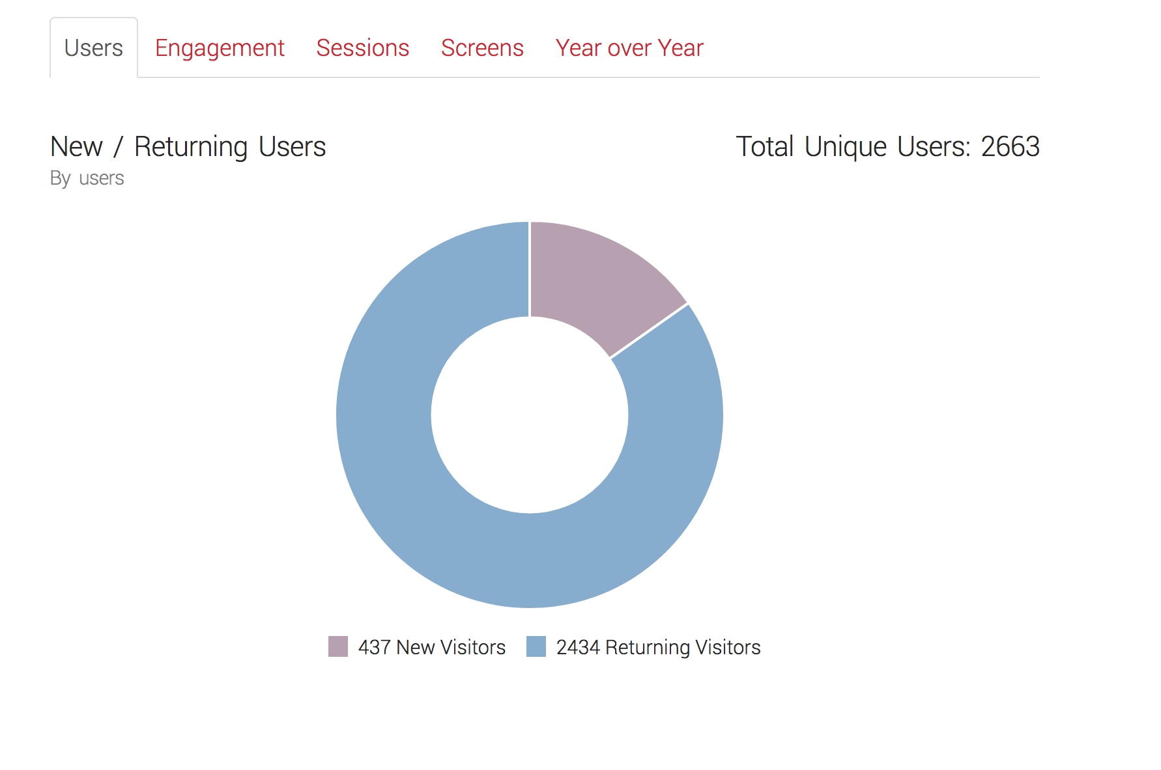
Diocesan Analytics

Slide 34
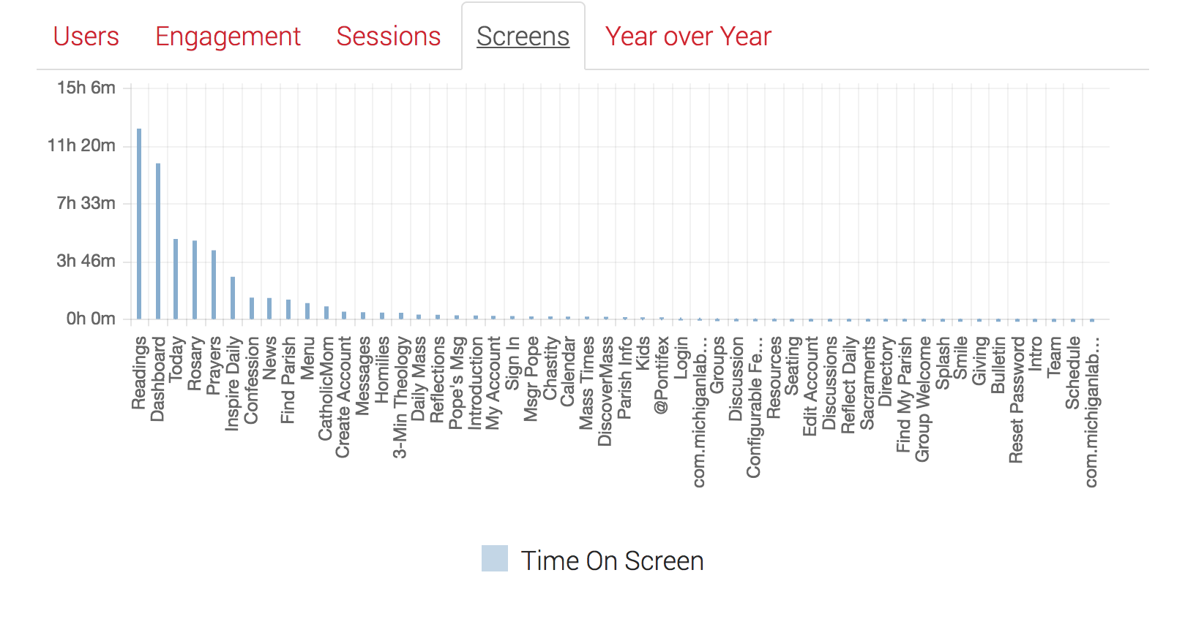
Diocesan Analytics
Open app because of notification, then read scripture

Slide 35
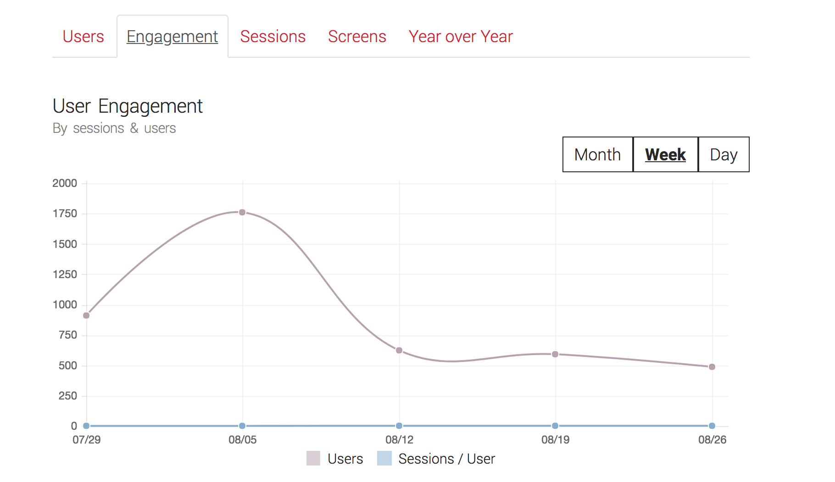
Diocesan Analytics

Slide 36
Diocesan Data to import
Parish Name | Address | Website | Mass and Confession Times | Social
St. Thomas | 1050 74th St. Byron Center 49315 | www.diocesan.com | S/ 10am M/ 8am T/ 8am W/ 8am TH/ 8am F/ 8am S/ 5pm SU/ 11am | www.facebook.com/parish

